Slide 1
BIIT
ProJECT : GUITAR APPLICATION
PROJECT BY : JIBRAN HAIDER
Language : swift
Environment : xcode

Slide 2
OBJECTIVES
- An Entertainment Application
- Compose Desired Tune
- Guitar Tutor and Lessons
- Share Composed Music

Slide 3
REQUIREMENTS
- Using finger gestures
- User can control by both hands
- Landscape Mode
- Requires speaker and a mic

Slide 4
APPLICATION USERS
Three type of users :
- Beginners
- Intermediates
- Experts

Slide 5
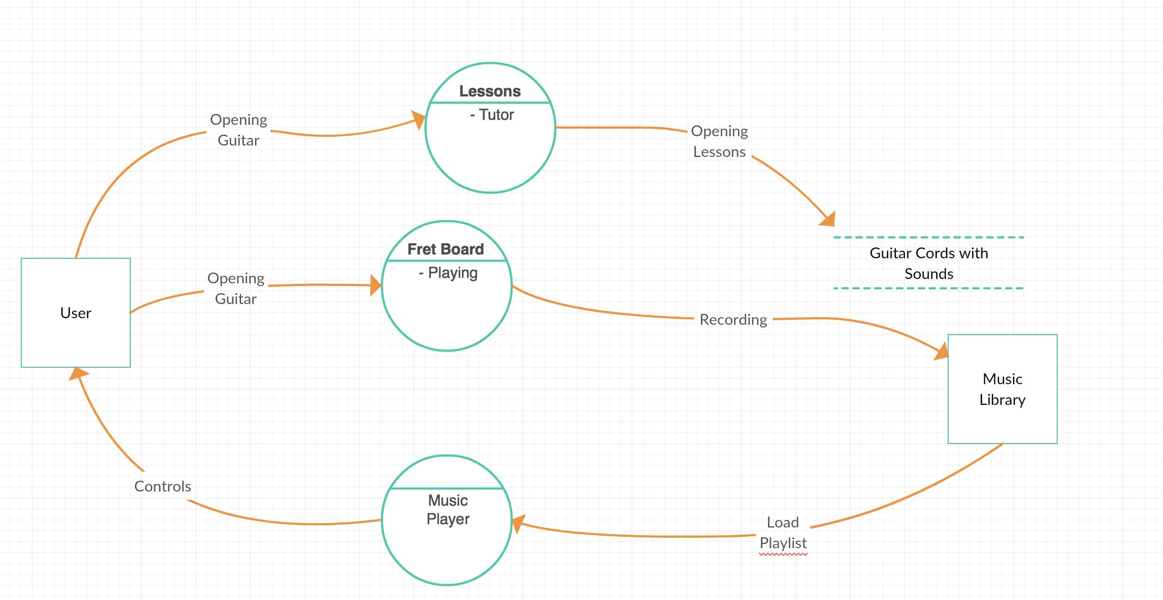
Data flow diagram

Slide 6
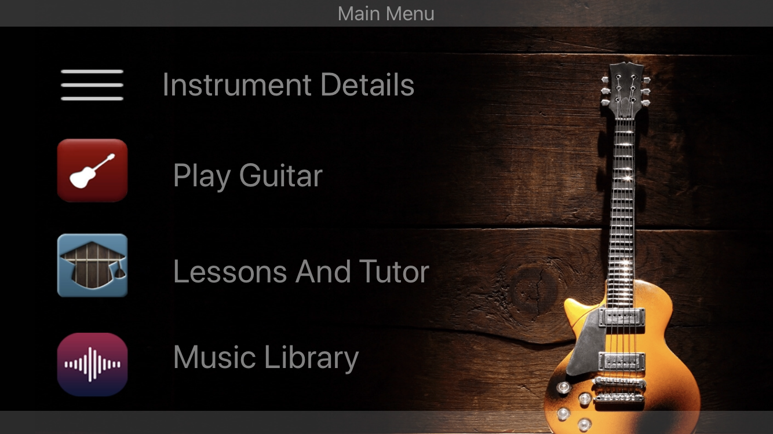
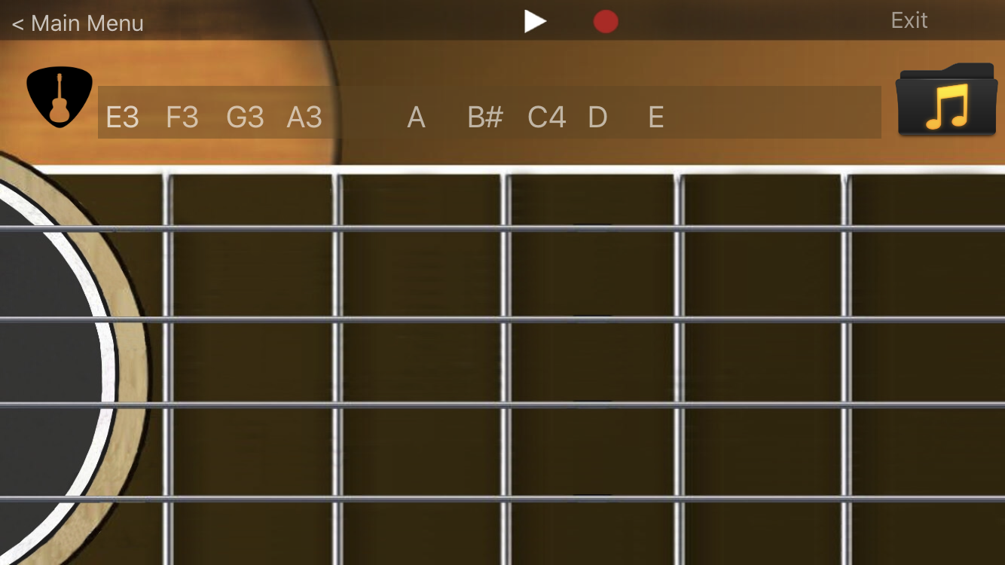
Mockups
Main Screen
Fret Board

Slide 7
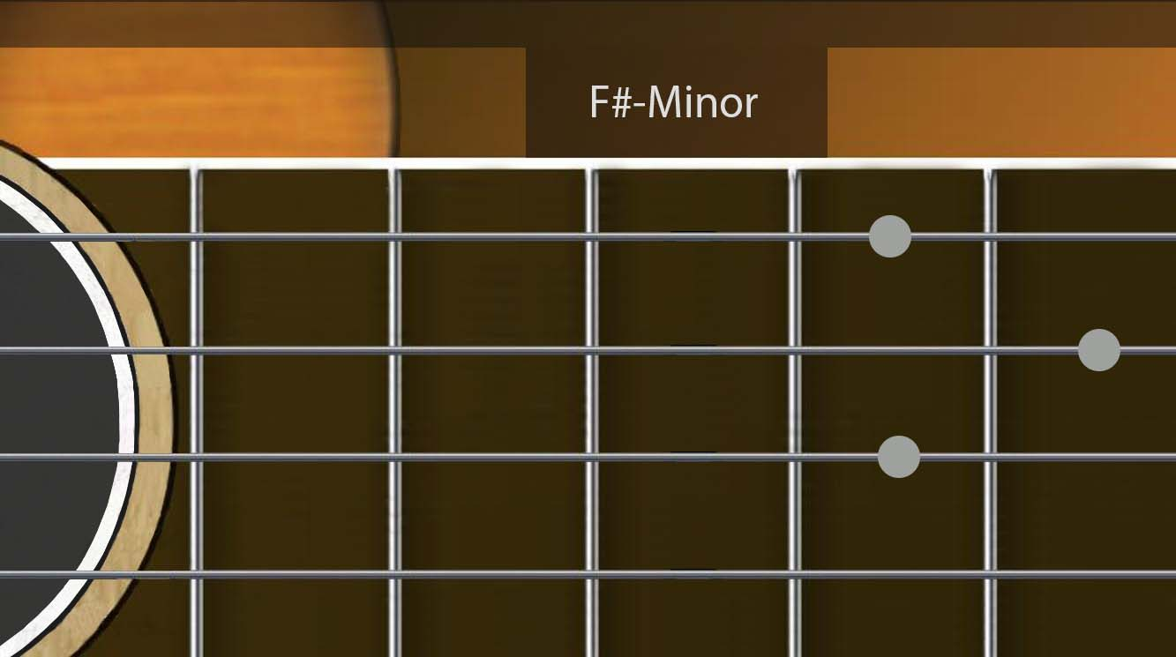
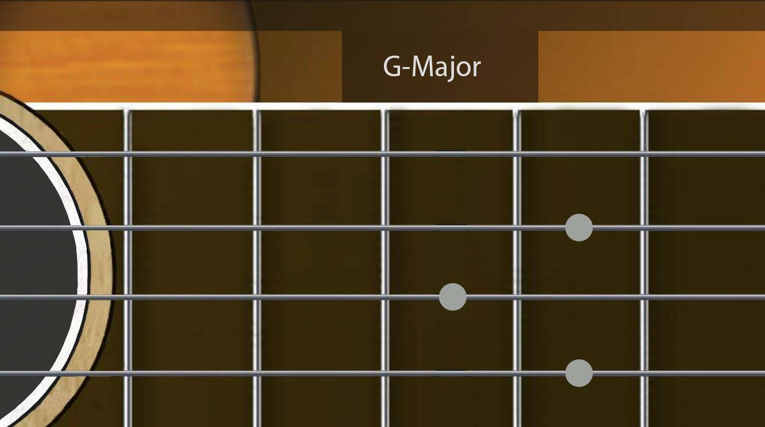
Mokups
LESSONS SCREENS

Slide 8
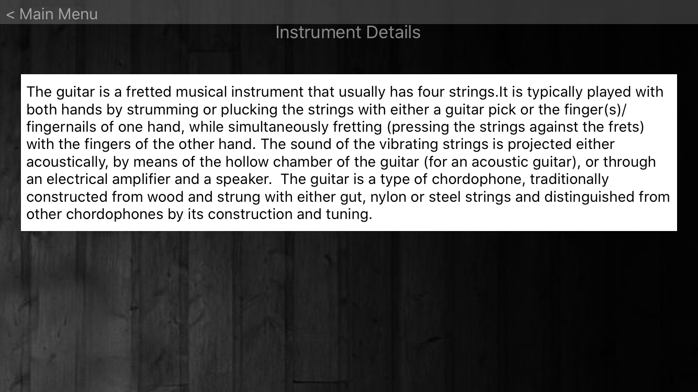
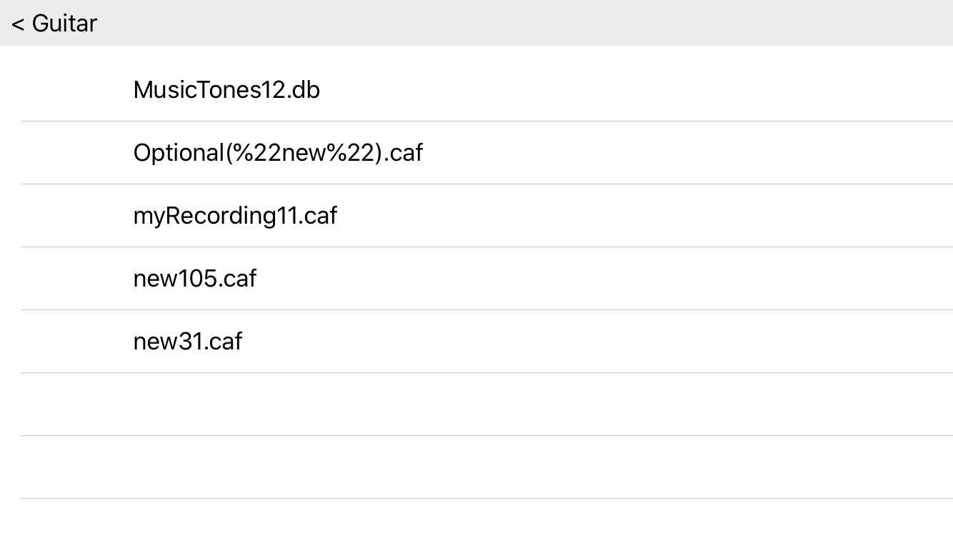
Mockups
INFORMATION SCREEN
MUSIC LIBRARY

Slide 9
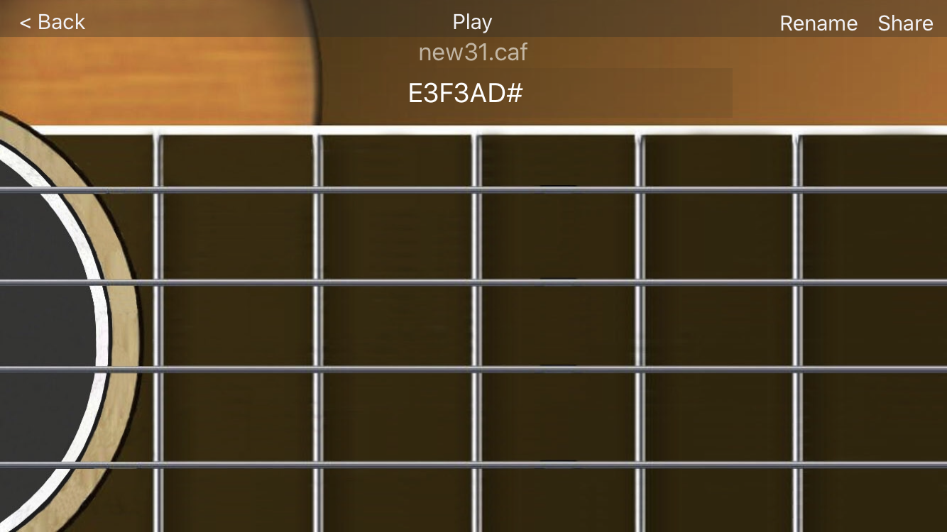
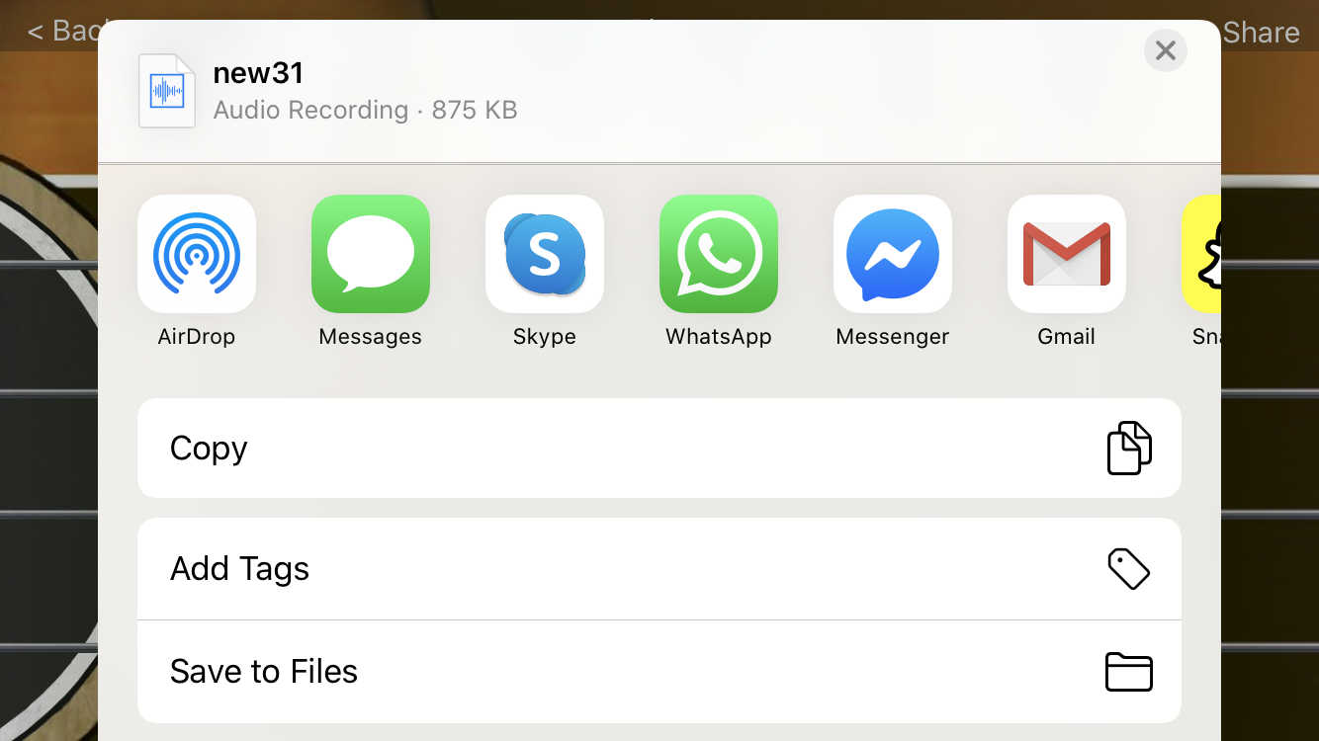
Mockups
RECORDED TUNE
FILE SHARING

Slide 10
THANK YOU

